Slide 1


ECXSystems
Helping MSPs Scale Your Business

Slide 2

The Struggle is Real
You’re overwhelmed by Escalations
SO proactive work is put to the side
SO you have to turn down revenue
SO you can’t grow to Manage
SO your engineers suffer burnout
SO you lose time delivering results
New Technology and Scale is a business risk
Owners are trapped in the Day-to-Day
Specialists are a big expense
Education takes time and resources

Slide 3

The Struggle is Real
You’re overwhelmed by Escalations
SO proactive work is put to the side
SO you have to turn down revenue
SO you can’t grow to Manage
SO your engineers suffer burnout
SO you lose time delivering results
New Technology and Scale is a business risk
Owners are trapped in the Day-to-Day
Specialists are a big expense
Education takes time and resources
...Leaving you
Overworked. Reactive. Stuck.

Slide 4
ECXSystems
An Alternative Solution to Advanced Engineering
How We Help
Level-3 & architect engineers as an extension of your team
Secure, real-time Rocket.Chat support
Proactive IT strategy for growth & efficiency

Slide 5






Making IT Work
Say “Yes” to More!
IT FOR IT
LANDING CLIENTS
STREAMLINING SERVICES
Drowning in escalations? Have a quick question? Want to pursue a new technology? From Cloud Migrations, to Cybersecurity, to Escalation support, ECXSystems is here to support.
By partnering with ECXSystems for presales, discovery, documentation, and Linux support, an MSP was able to close a deal that boosted revenue by 50%.
Our onboarding process—encompassing discovery, secure password collection, and thorough documentation—ensures that new clients are up and running without delay.

Slide 6

...but wait, there’s more

Slide 7
...but wait, there’s more

Slide 8
SGM EVENT DISCOUNT
Get 5 FREE hours with a 15-hour Starter Bundle
That’s $1,000+ in free engineering time
How to claim: Be a current SGM Partner or sign up for a future event

Slide 9
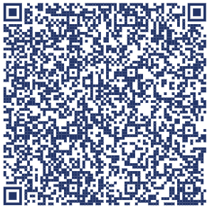
SGM EVENT DISCOUNT
RAFFLE!!
One person wins a full 15-hour Starter Bundle FREE
$3500+ in Value
Get 5 FREE hours with a 15-hour Starter Bundle
That’s $1,000+ in free engineering time
How to claim: Be a current SGM Partner or sign up for a future event

