Slide 1




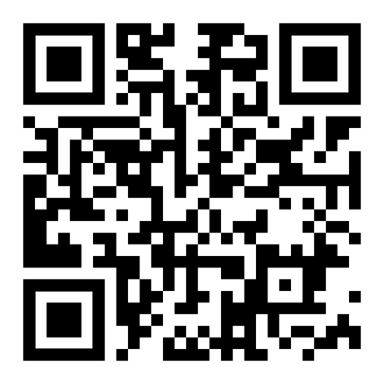
Are you elevating your MSP to MSSP?

Slide 2



Join
with this special code: MSP10
12 month complimentary membership to join the community with other MSPs and that helps lead generate and access to amazing vendors.

Slide 3

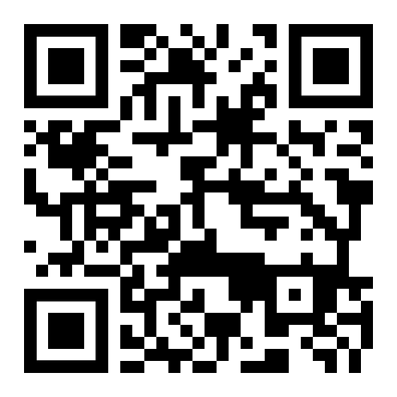
Join Global Trusted Advisors Movement

Slide 4




Are you the Expert in your customers industry ?
Are you the Authority in your customers industry ?
Are you the IT Guy or the Trusted Advisor?
7 more questions to help you get your Expert Authority Score and learn how to raise it to 10

Slide 5

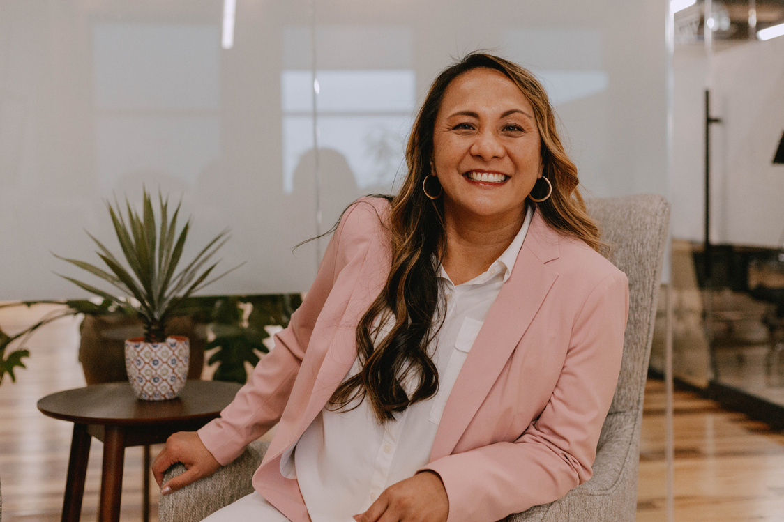

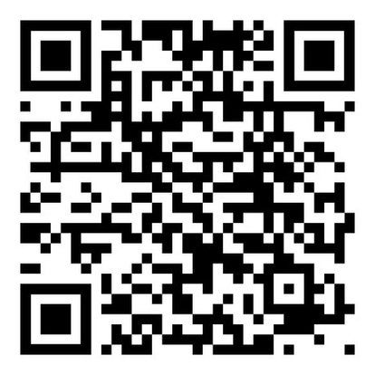
Get your expert authority score at our booth or connect with me on LinkedIn:
Charlene Ignacio
Serial Entrepreneur & Multi Industry CEO

